Slide 1
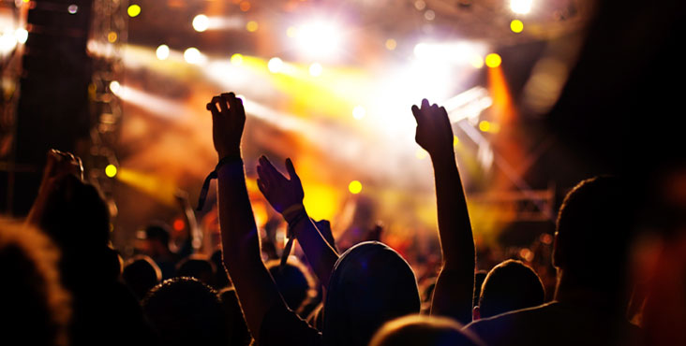

Event Recommender
Dhiviya Dhanasekar | Kushal Palesha |Prathiba Nagarajan

Slide 2
Outline
Why an events recommender?
Implementation
Results

Slide 3

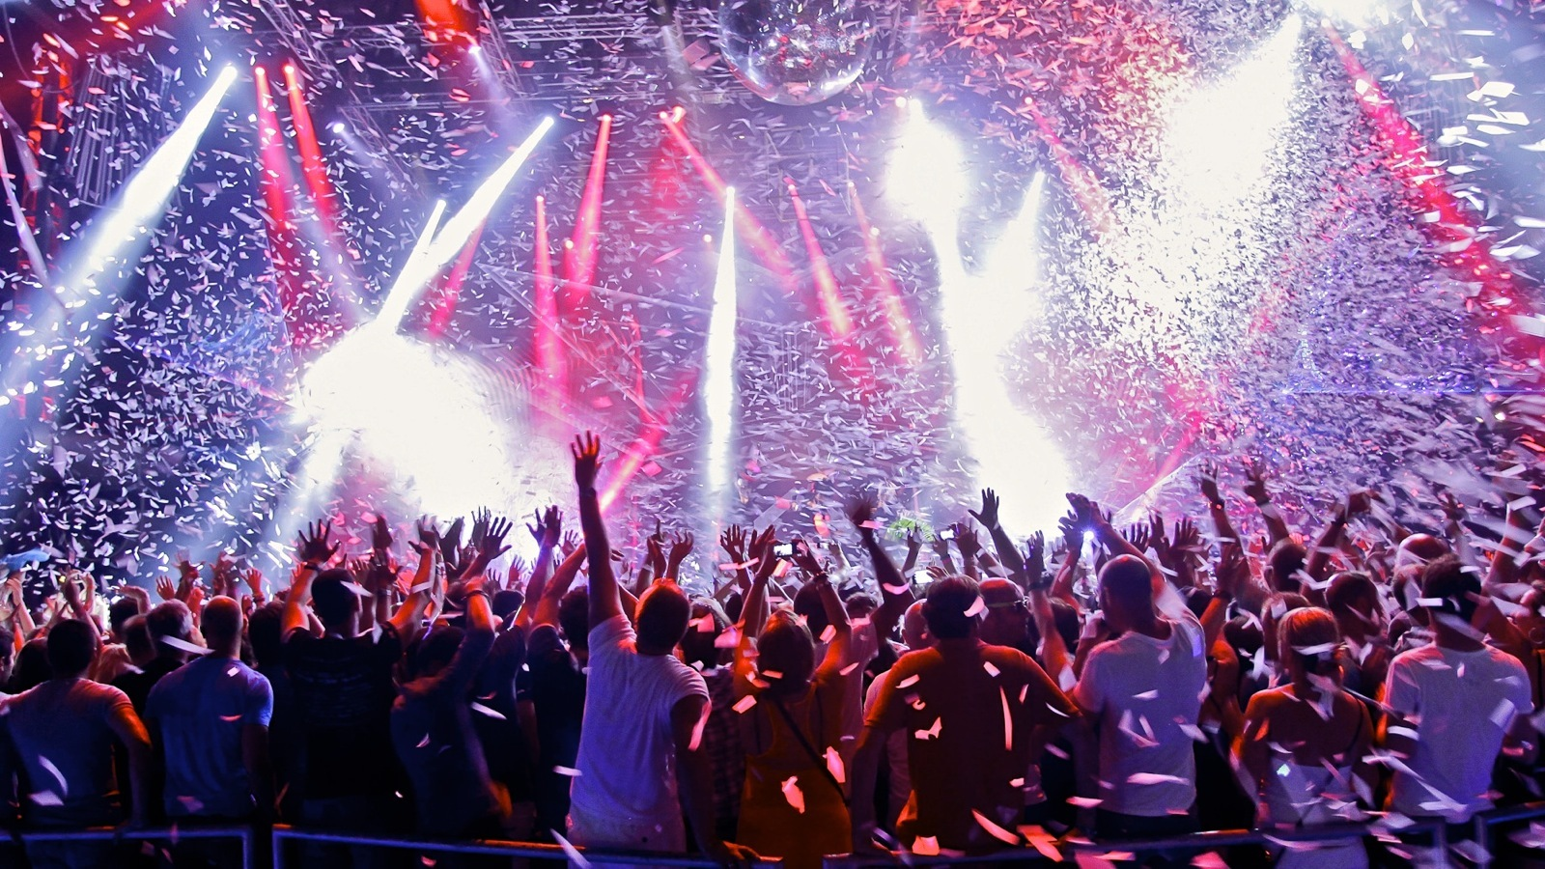




What does Homer like?

Slide 4
How?

Slide 5
Challenges
Too many features/attributes
Bulk Loading into Hbase
Out of RAM – GB of data

Slide 6
Demo & Results

Slide 7
Summary

Slide 8
Appendix
Github URL: https://github.com/dhiviyadhanasekar/Events_Recommender
Dataset: https://www.kaggle.com/c/event-recommendation-engine-challenge/data

